Slide 1
HISP 200: The Everyday and the American Built Environment
Lecture 01
Viewscapes

Slide 2
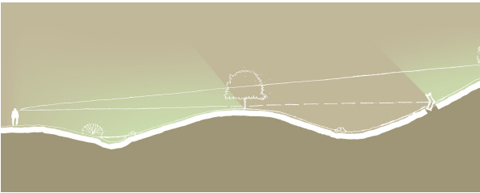
Terminology
View
Landscape
Watershed
Viewshed
Viewscape

Slide 3
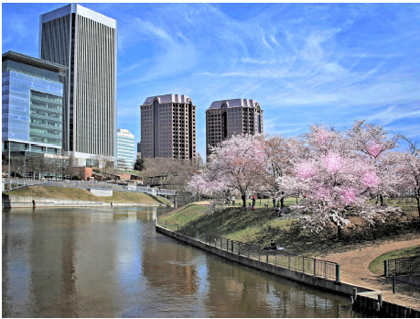
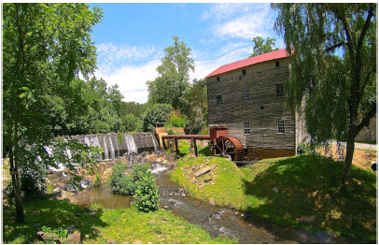
Viewscapes
Are Viewscapes Important?
Mental Health
Physical Health
Cognitive Stimulus

Slide 4
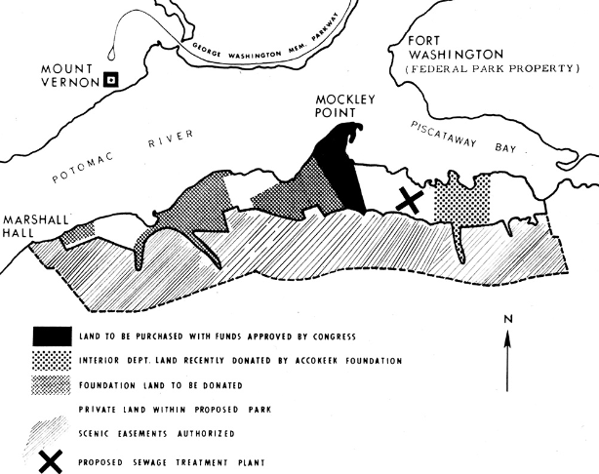
Preserving Viewsheds: Mount Vernon
George Washington’s Mount Vernon:
A Case Study
First Viewshed Preserved in the Nation

Slide 5
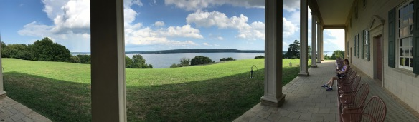
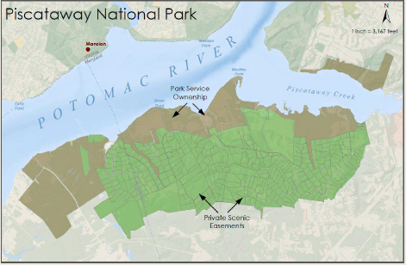
Preserving Viewsheds: Mount Vernon

Slide 6
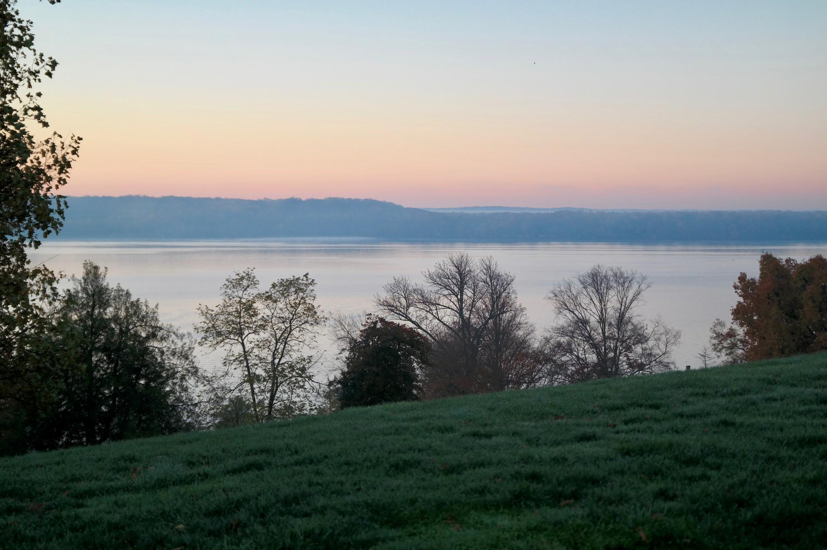
Preserving Viewsheds: Mount Vernon

Slide 7
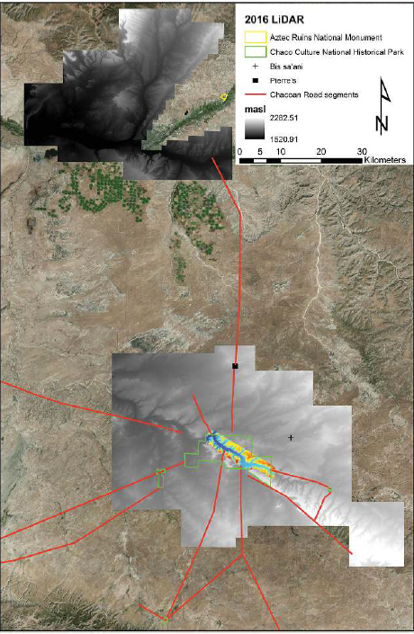
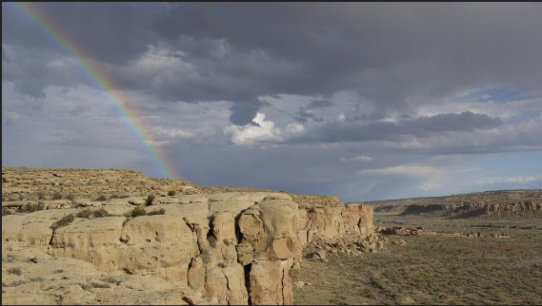
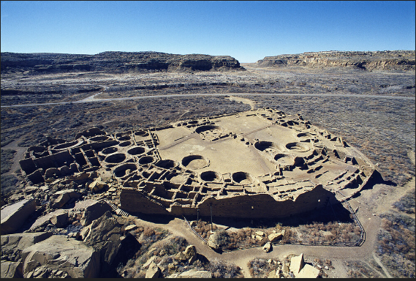
Viewscapes of Greater Chaco
Pueblo Bonito
Chaco Landscape

Slide 8
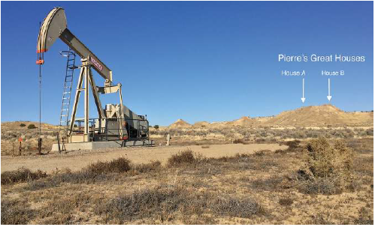
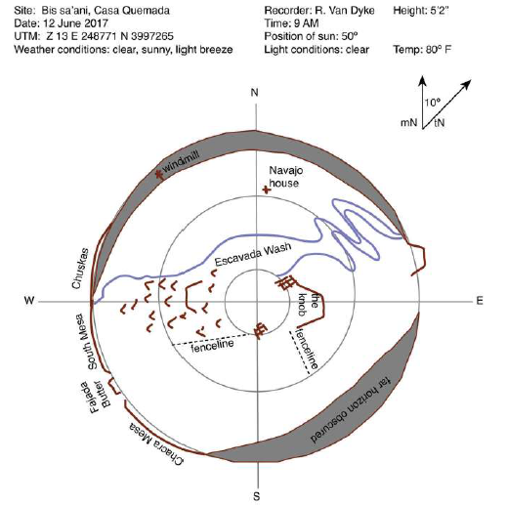
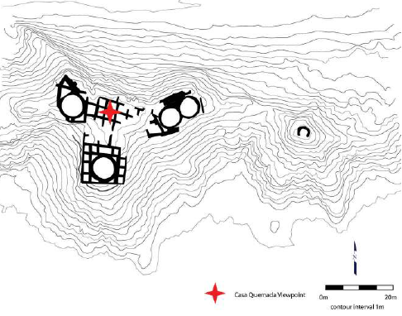
Viewscapes of Greater Chaco

Slide 9
Viewscapes of Greater Chaco
Bis sa’ani
http://read.upcolorado.com/projects/the-greater-chaco-landscape/resource/video-11-1-bis-sa-ani-viewscape
Pierre
http://read.upcolorado.com/projects/the-greater-chaco-landscape/resource/video-11-2-pierre-s-pinnacle-viewshed-5

Slide 10
Viewscapes and Soundscapes of Greater Chaco
Full Video Presentation
http://read.upcolorado.com/projects/the-greater-chaco-landscape/resources?page=2

